Slide 1
Client – Server Model Revisited
System D-Bus
Debian 9
Raspberry Pi – Raspian
Systemd
Python3: Rpi.GPIO, pydbus, subprocess.run()
Last month – Demonstration of Session D-Bus.
History / theory of the above.
Demo Client/Server - System D-Bus on laptop.
Demo Raspberry Pi – Debian 9 – Client/Server – System D-Bus – GPIO.
Waikato Linux User Group – 26 June 2017 – Ian Stewart

Slide 2

Client / Server. Traditional Model
Inter-Process Communication (IPC) over the internet.
Client initiated request. Server awaits requests and responds.

Slide 3

Client / Server. Traditional Model
Inter-Process Communication over the internet
Client
Servers
OR: Multiple Servers / Single client

Slide 4
Client / Server. Desktop-Bus Model
Inter-Process Communication over the System D-Bus
Server App
D-Bus publish.
D-Bus method call
response.
Systemd control.
Auto start on boot.
GPIO port monitoring
Repeating Timer.
Client App
GUI Python Gtk.
D-Bus subscribe.
D-Bus initiate
method call.
D-Bus
Server(s)
Servers App
Processing module.
Stuff

Slide 5
Desktop-Bus
History
Initiated by Havoc Pennington from Red Hat
Initial release: November 2006; 10 years ago
Stable release: 1.10.18 / April 5, 2017; 2 months ago
Operating system: Cross-platform
Website: https://www.freedesktop.org/wiki/Software/dbus

Slide 6
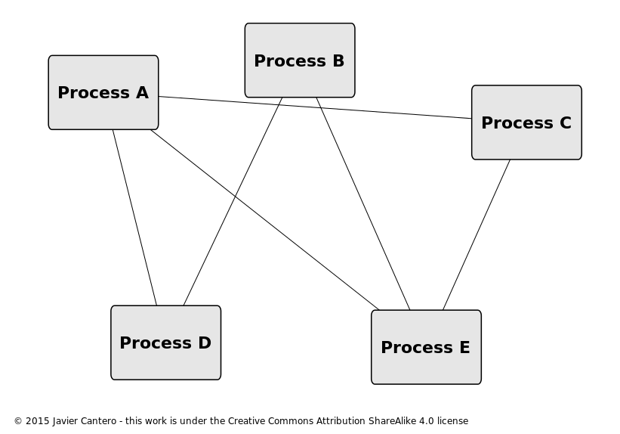
Desktop-Bus
Without D-Bus - Peer-to-peer

Slide 7
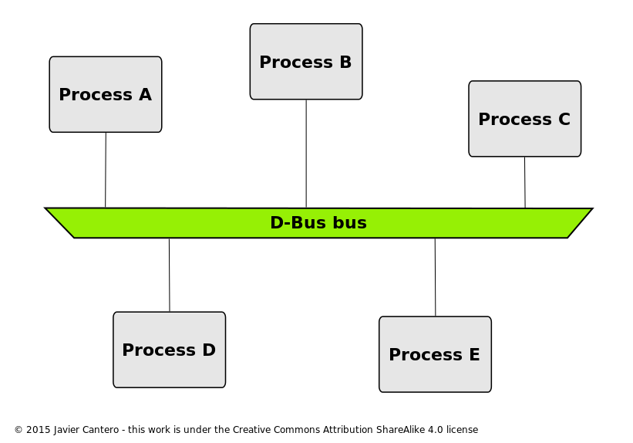
Desktop-Bus
D-Bus simplifies the IPC requirements with one single shared channel for System and one for User Session

Slide 8
Desktop-Bus
D-BusSystem and Session
Linux desktop environments take advantage of the D-Bus facilities by instancing not one bus but many:
A single system bus, available to all users and processes of the system, that provides access to system services (i.e. services provided by the operating system and also by any system daemons)
A session bus for each user login session, that provides desktop services to user applications in the same desktop session, and allows the integration of the desktop session as a whole

Slide 9
Desktop-Bus
Permission with system D-Bus
$ ls /usr/share/dbus-1/
accessibility-services services system.conf system-services
interfaces session.conf
$ ls /etc/dbus-1/
session.d system.d system-local.conf
ian@X:/etc/dbus-1$
$ cat /etc/dbus-1/system-local.conf (extract)
<busconfig>
<policy context="default">
<!-- Added -->
<allow own="*"/>
<allow send_type="method_call"/>
<!-- End of add -->

Slide 10
Systemd
systemd is an init system used in Linux distributions to bootstrap the user space and manage all processes subsequently.
It is published as free and open-source software under the terms of the GNU Lesser General Public License (LGPL) version 2.1 or later.
One of systemd's main goals is to unify basic Linux configurations and service behaviours across all distributions.

Slide 11
Systemd
Systemd Permission with system D-Bus
Original author(s): Lennart Poettering, Kay Sievers, Harald Hoyer, Daniel Mack, Tom Gundersen and David Herrmann.
Initial release: 30 March 2010; 7 years ago
Stable release: 233 (March 1, 2017; 3 months ago)
Opera
Repository: https://github.com/systemd/systemd.git
Website: https://freedesktop.org/wiki/Software/systemd/

Slide 12
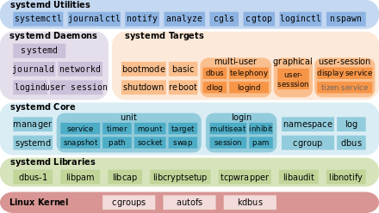
Systemd
The architecture of systemd
Server App

Slide 13
Systemd – folders
$ ls /etc/systemd/
bootchart.conf logind.conf resolved.conf system.conf user
journald.conf network system timesyncd.conf user.conf
$ ls /etc/systemd/system
/etc/systemd/system$ ls
bluetooth.target.wants hybrid-sleep.target.wants
dbus-org.bluez.service multi-user.target.wants
dbus-org.freedesktop.Avahi.service network-online.target.wants
dbus-org.freedesktop.ModemManager1.service paths.target.wants
dbus-org.freedesktop.nm-dispatcher.service printer.target.wants
dbus-org.freedesktop.thermald.service project_1_server_1_app_1.service
default.target.wants project_1_server_2_app_1.service
display-manager.service sockets.target.wants
display-manager.service.wants suspend.target.wants
final.target.wants sysinit.target.wants
getty.target.wants syslog.service
graphical.target.wants timers.target.wants
hibernate.target.wants
Project_1
Server_
App_1

Slide 14
Systemd – folders
Application started by systemd, edited by you
~/project_1/server_1$ ls -l
total 8
-rwxrwxr-x 1 ian ian 4651 Jun 26 16:06 app_1
Server Application off ~home folder

Slide 15
Debian 9 - “Stretch”
HIstory
Initiated by Ian Murdock
Initial release: September 1993; 23 years ago
Latest release: 9.0 (Stretch) June 17, 2017; 8 days ago
Operating system: Unix like, open source
Website: https://www.debian.org

Slide 16
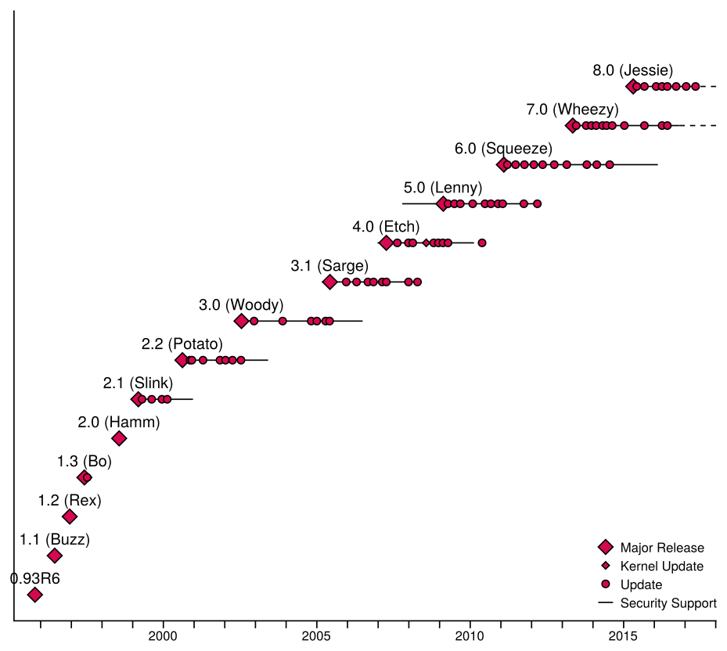
Debian 9 - “Stretch” - History
HIstory

Slide 17
Debian 9 - “Stretch”
Downloading Live Flavours
https://cdimage.debian.org/debian-cd/current-live/amd64/bt-hybrid/
debian-live-9.0.1-amd64-cinnamon.iso.torrent 2017-06-20 09:01 79K
debian-live-9.0.1-amd64-gnome.iso.torrent 2017-06-20 09:01 44K
debian-live-9.0.1-amd64-kde.iso.torrent 2017-06-20 09:02 49K
debian-live-9.0.1-amd64-lxde.iso.torrent 2017-06-20 09:01 74K
debian-live-9.0.1-amd64-mate.iso.torrent 2017-06-20 09:02 76K
debian-live-9.0.1-amd64-xfce.iso.torrent 2017-06-20 09:02 73K

Slide 18
Debian 9 - “Stretch”
R-Pi use “testing”
$ ls
apt.conf.d preferences.d sources.list sources.list.d trusted.gpg.d
Edit “jessie” to “testing”
Now “stretch”
...then
sudo apt dist-upgrade
Also rpi-update for firmware
deb http://mirrordirector.raspbian.org/raspbian/ testing main contrib non-free rpi

Slide 19
Debian 9 - “Stretch”
R-Pi use “testing” / “stretch” / Debian 9:
Reasons:
Python 3.5 – subprocess.run()
Glib > 2.46 for pydbus. Stretch at 2.50
Issues:
Gtk upgraded from 3.10 to 3.22. Switches to using css.
Need to find .css files so Gtk widgets have characteristics. So a button doesn’t look like a label.
Pip3 the pydbus module
Re-install Rpi-GPIO module

Slide 20
System D-Bus (not Session D-Bus)
Server 1
pydbus module for IPC.
Publish
and
Method Call
Server 2
pydbus module for IPC.
Publish
and
Method Call
Clients 1 to 6
Gtk GUI
Display data from the server
Subscribe
and submit Method Calls
Server generator program
systemd
Demo Block Diagram

Slide 21
Client Server via System D-Bus
R-Pi GPIO ports
pydbus
System
D-Bus
Pulse Generator
-
Simulate
Bike
Wheel rotating
Slide controls
Frequency
0.25Hz to 10Hz
Server
App #1
GUI
Client
Subscribes to Server publishing.
Performs Method Calls
Server
App #2
Server
App #3
Server
App #4
systemd

Slide 22
Do Demo’s
Laptop
Raspberry Pi – With signals on GPIO ports.

